Slide 1
ME490 자율주행시스템을 위한 프로그래밍 Programming for Autonomous System
카이스트 기계공학과

Slide 2
Goal of this course
Let students learn and experience how recent AI/Autonomous vehicle techniques are implemented in the mechanical system
학생들이 최근 주목받는 인공지능/자율주행 등 4차산업혁명 기술이 어떻게 기계공학과에서 다루는 시스템에 적용되는지를 배우고 실습하도록 하는 것
Ultimately, students would know that the AI TOOLS are (just) tools that you could use for making machines autonomous
그리하여 학생들이 시스템을 발전시키는데 AI 관련 기술을 도구로 사용할 수 있다는 것을 알게 하는 것

Slide 3
Feedback from Capstone 1
Pros
Challenging, fruitful curriculum
도전적이지만 많은 것을 배울 수 있었음
Excellent TA support 조교들의 지원에 감사
Cons
Nonsystematic coding curriculum 소프트웨어에 대한 체계적 교육이 없어
Time consuming coding and debugging 프로그래밍에 시간이 너무 많이 할애 되었음
Rule changes 규정 등의 변경에 대한 불만

Slide 4
Plans for Capstone 2
Pros
Challenging, fruitful curriculum
도전적이지만 많은 것을 배울 수 있었음
Excellent TA support 조교들의 지원에 감사
Attempt to improve the Cons
Programming for autonomous system ME491 창시구프로그래밍 교육 및 실습
Rule setting: TA pre-runs (software wise)
The changes in rule (if any) would be introduced to make your life easy !

Slide 5
Recall, your autonomous vehicle system
Controller
Sensors
Plant
Actuators

Slide 6
Autonomous vehicle system
Go forward
Controller
With speed v
With direction θ, combinations of n-wheels
- direct controller by X-box
- Previous 창시구 (시모제, 자동제어)
- New 창시구 (자율주행, 딥러닝)
- autonomous control: find out where & how to go and come back
TOOLs for making system autonomous
“SLAM”
“Machine learning”
“Neural net CNN”
“Reinforcement learning”
“Deep learning”
SLAM: Simultaneous Localization And Mapping

Slide 7
Programming for autonomous system
(Thanks to) Open source software
Open-source software (OSS) is a type of computer software whose source code is released under a license in which the copyright holder grants users the rights to study, change, and distribute the software to anyone and for any purpose.
Open-source software may be developed in a collaborative public manner.
According to scientists who studied it, open-source software is a prominent example of open collaboration. [from wiki]
- ME490 Programming for autonomous system
“SLAM”
“Machine learning”
CS376
CE481
“Neural net CNN”
CS470
CS672
“Reinforcement learning”
- ME401 Capstone design 2
CS774
“Deep learning”

Slide 8
Programming for autonomous system
Open source software
Library, package, …
Labview
Go forward
With speed v
With direction θ
Sensors: LIDAR, camera, etc
ROS
OpenCV
Hector SLAM
Pytorch
“SLAM”
“Machine learning”
“Neural net CNN”
“Reinforcement learning”
“Deep learning”

Slide 9
Recall, final mission of Capstone 1
ROS
Hector SLAM
Pytorch
“SLAM”
“Machine learning”
“Neural net CNN”
“Reinforcement learning”
“Deep learning”

Slide 10
Recall, final mission of Capstone 1
ROS
Hector SLAM
Pytorch
“SLAM”
“Machine learning”
“Neural net CNN”
“Reinforcement learning”
“Deep learning”

Slide 11


Final mission (draft)
Goals
Quickly (Design)
Escape the maze (SLAM)
Pick all balls (DQN)
Drop to each basket (CNN)
ROS
Hector SLAM
Pytorch
“SLAM”
“Machine learning”
“Neural net CNN”
“Reinforcement learning”
“Deep learning”

Slide 12
Active learning (Education 4.0)
트랙 1: 플립드 러닝 방식 (교수님께서 사전 제작하신 동영상강의(필수)를 KLMS에서 학습 + 오프라인 상호협력학습)
트랙 2: 액티브 러닝 50% 이상 (수업시간 중 일방향 강의비중을 50%미만으로 줄이고, 토론/ 문제풀이/ 프로젝트 등의 다양한 학습활동(액티브 러닝) 으로 수업설계)
Track 2: One-directional lecture: Active learning = 50:50
트랙 3: 액티브 러닝 100% (수업시간 중 일방향 강의 없이, 액티브러닝으로 수업설계)
 | Mon | Tue | Wed | Thu
4:00-5:00 | Class
5:00-6:00
6:00-7:00
7:00-8:00
8:00-9:00
Practice

Slide 13
Course schedule
W | Date | Class | Active learning
1 | 8/27 | 0. Course introduction | Programing structure: Python, PyTorch
2 | 9/3 | 1.0 Machine learning basic | Programing of MSE
3 | 9/10 | 1.1 Neural Network | Programing of MNIST or Dog/cat
4 | 9/17 | 1.2 Convolutional Neural Network | Quiz #1 Python & PyTorch Programing of CNN 9/21 Capstone 1st design review
5 | 9/24-26 | Choosuk | No Class
6 | 10/1 | 2.0 SLAM basic | Code review #2 due: Customized CNN Programing structure: ROS
7 | 10/8 | 2.1 SLAM package in ROS | Programing of Hector SLAM Code Assignment #3 due: Basic ROS
8 | 10/15-17 | Midterm | No Class, No exam

Slide 14
W | Date | Class | Active learning
9 | 10/22 | 2.2 SLAM for Capstone project | Programing of SLAM & path planning 10/26 Capstone 2nd design review
10 | 10/29 | 3.0 Reinforcement learning | Code review #4 due: Customized SLAM Programing of DQN
11 | 11/5 | 3.1 Deep Q-learning: environment | Programing of simulator / emulator
12 | 11/12 | 3.2 DQN: learning | Programing of Capstone-vehicle learning network
13 | 11/19 | 3.3. DQN: testing | Code review #5 due: DQN code Programing of Capstone-vehicle testing
14 | 11/26 | Real system implementation | Capstone system testing 11/30 Capstone Final demo
15 | 12/3 |  | Code review #6 due: Total system code

Slide 15
Course Syllabus
Lecture
Class lecture & active learning: Mon 4:00~5:00 pm, ME building 2OOO
Evaluation guideline
1) Six code review reports : #1~#5 (10%, each), #6 (30% each)
2) Attendance and class participation 20%
Syllabus, weekly notices, forms, and lecture notes will be uploaded on the course web at KLMS, and github

Slide 16
Programming structure & code review
Data prep programming
Architecture programing
Module programing
Inter-module control
Interface programing
Interface for software modules
Interface for different devices
Procedure
Sample code(s) will be provided and you are supposed to modify them to fit your system
Code review of sample code
Code review of your own (customized) code

Slide 17
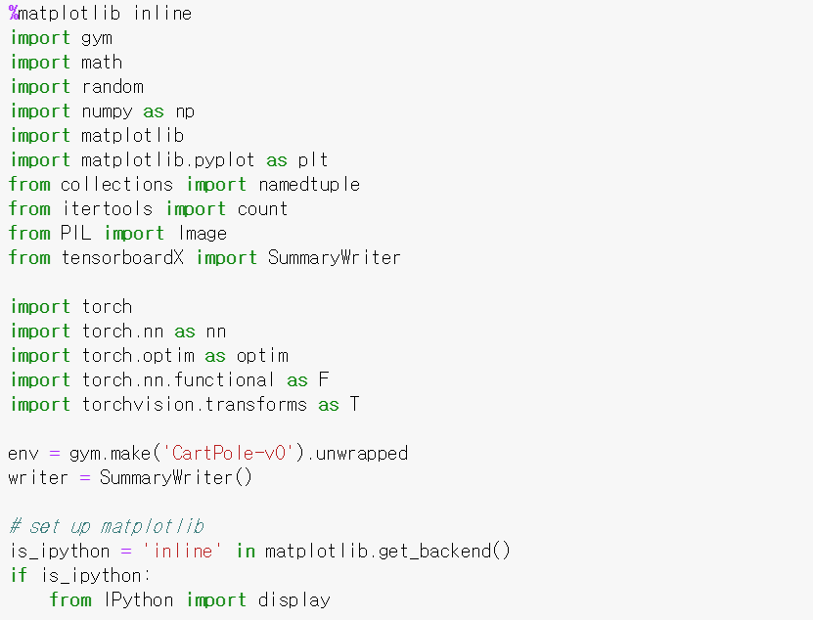
Ex) Programming structure & code review
파이썬의 필요한 모듈을 임폴트
import necessary module
*모듈(Module)은 파이썬 코드를 논리적으로 묶어서 관리하고 사용할 수 있도록 하는 것으로, 보통 하나의 파이썬 .py 파일이 하나의 모듈이 된다. 모듈 안에는 함수, 클래스, 혹은 변수들이 정의될 수 있으며, 실행 코드를 포함할 수도 있다
모듈안의 함수만 임폴트
import necessary function from module
*하나의 모듈 안에는 여러 함수들이 존재할 수 있는데, 이 중 하나의 함수만을 불러 사용
머신 러닝 라이브러리인 파이톨치 임폴트
import PyTorch, a machine learning library
시뮬레이션 라이브러리 gym에서 cartpole 시뮬레이션 환경을 불러서 env라는 클라스명으로 저장
학습 시키는 네트워크의 성능을 실시간으로 저장하여 관측하기위해 tensorboardX의 함수 정의

Slide 18
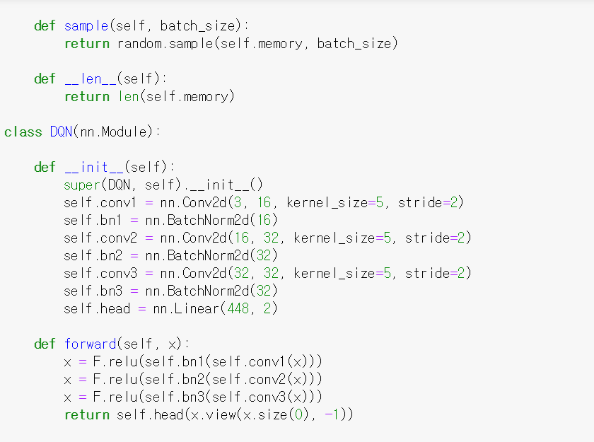
Ex) Programming structure & code review
batch 사이즈에 맞게 저장된 데이터 셋을 랜덤하게 선택해주는 함수
메모리에 할당된 사이즈 출력 함수
DQN_모델을 정의하는 클래스
DQN 네트워크의 layer구조를 설정 여기서는 CNN을 사용
Forward step에서 넣어줄 activation function 정의

Slide 19
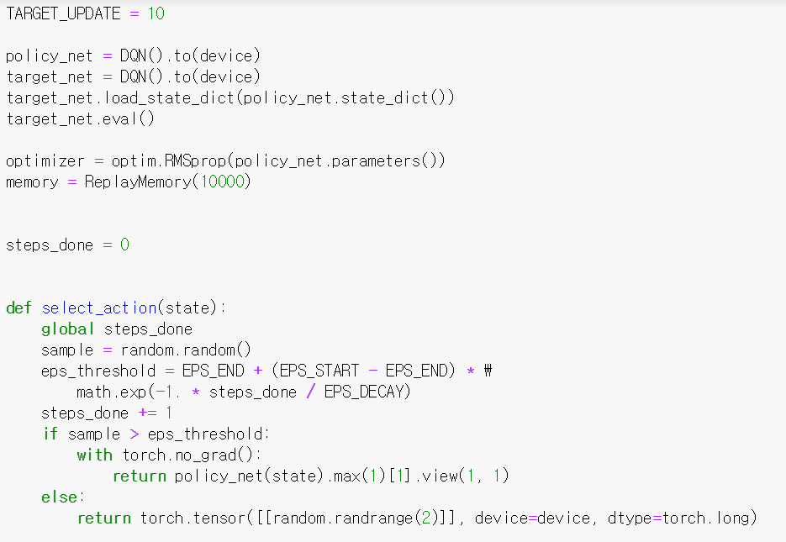
Ex) Programming structure & code review
위에서 설정한 모델 정의(double DQN을 두 모델 정의)
최적화 알고리즘 정의(여기서는 RMS 사용)
Replaybuffer사이즈 및 함수 선언
Epsilon greedy 알고리즘에 따른 action 선택 함수

Slide 20
Ex) Programming structure & code review
전체 프로그래밍의 기능적 모듈 등에 대한 분석
Also analyze the functional modules of main-simulator-test_DQN code
Main.py (learning)
Simulator.py
Test_DQN.py

Slide 21
Ex) Programming structure & code review
각 모듈 코드의 개념, 구조, 세부 내용에 대한 리뷰 작성
Review the concept, sub-structure of the code
Loop A
Action
Main_learning.py (learning)
Import simulator.py
import DQN.py
Parameter Setting
Batch size
Epsilon
Learning rate, etc
[DQN] [Simulator]
Set DQN parameters
Set simulator parameters
Image(grey scale) information
main:
env: simulator(parameters defined above)
mode: DQN (parameters defined above)
Loop A
Claim learning of the above neural network model
RGB display for user
Q: Are you familiar to functions, modules, packages, class in Python?

Slide 22
Python package
파이썬에서 모듈은 하나의 .py 파일을 가리키며, 패키지는 이러한 모듈들을 모은 컬렉션을 가리킴
In Python, a module means a single .py file, and a package means a collection of these modules.
파이썬의 패키지는 하나의 디렉토리에 놓여진 모듈들의 집합을 가리키는데, 그 디렉토리에는 일반적으로 __init__.py 라는 패키지 초기화 파일이 존재
A package in Python refers to a set of modules placed in a directory, which usually contains a package initialization file called __init__.py
package
package
module
module
http://pythonstudy.xyz/python/article/

Slide 23
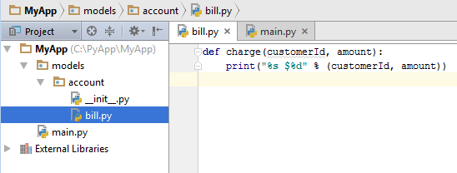
Python package
파이썬으로 큰 프로젝트를 수행하게 될 때, 모든 모듈을 한 디렉토리에 모아 두기 보다는 각 영역별로 디렉토리/서브디렉토리를 만들고 계층적인 카테고리로 묶어서 패키지별로 관리하는 것이 편리하고 효율적이다.
When you run a large project with Python, it's convenient and efficient to group all the modules in a hierarchical under the directories/subdirectories rather than a directory and manage them on a package-by-package basis
subdirectory of “account” package
directory 1 of “models” package
directory 2
modules
http://pythonstudy.xyz/python/article/

Slide 24
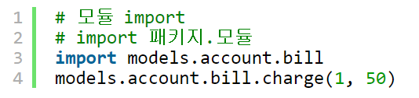
Import Python package
패키지내 모듈을 import하기 위해서는 "import 패키지명.모듈명"과 같이 패키지명을 앞에 붙여 사용한다.
To import the module in the package, use the package name prefixed with "import package name.module name".
package name
module name
function name

Slide 25
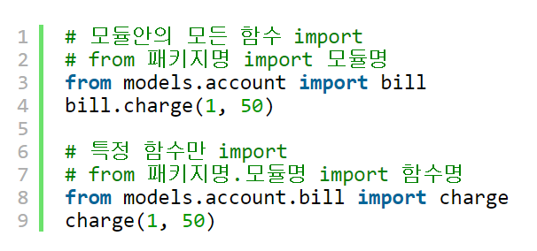
Import Python package
To import a module, try "from package import module"
To import a function, try “from package.module import function”
module name
package name
function name
package + module name
http://pythonstudy.xyz/python/article/

Slide 26
Machine learning code…
import torch
class MyReLU(torch.autograd.Function):
""" XXXX
def forward(ctx, input):
""" XXXX
def backward(ctx, grad_output):
""" XXXX
input, = ctx.saved_tensors
grad_input = grad_output.clone()
grad_input[input < 0] = 0
return grad_input
dtype = torch.float
[http://busterworld.tistory.com/64 [BW]]

Slide 27
Python Class
클래스는 데이터와 그에 대한 처리를 하나로 정의한 것으로 함수와 유사 개념
A class defines data and its processing as one group
class Bdb:
"""XXXXXXXX
count = 0
def __init__(self, skip=None):
self.skip = set(skip) if skip else None
self.breaks = {}
self.fncache = {}
def canonic(self, filename):
if filename == "<" + filename[1:-1] + ">":
return filename
Class name
Description code
http://www.dongwun.com/tc/142

Slide 28
Method: member of Python class
메서드(method): 클래스의 행위를 표현하는 것으로 클래스 내의 함수
Method is a function in a class expressing the behavior of the class
class Bdb:
"""XXXXXXXX
count = 0
def __init__(self, skip=None):
self.skip = set(skip) if skip else None
self.breaks = {}
self.fncache = {}
def canonic(self, filename):
if filename == "<" + filename[1:-1] + ">":
return filename
Method
http://pythonstudy.xyz/python/article/

Slide 29
Class variables
클래스 변수 (class variable)은 메서드 밖에 존재하는 변수로 "클래스명.변수명" 으로 엑세스 할 수 있다.
Class variables is defined outside the method by “class.variable”
class Bdb:
"""XXXXXXXX
count = 0
def __init__(self, skip=None):
self.skip = set(skip) if skip else None
self.breaks = {}
self.fncache = {}
def canonic(self, filename):
if filename == "<" + filename[1:-1] + ">":
return filename
Class variable, accessed by ‘Bdb.count’
http://pythonstudy.xyz/python/article/

Slide 30
Instance variables
인스턴스 변수(Instant variable)는 메서드 안에서 사용되면서 "self.변수명"처럼 사용된다.
Instant variable is used in a method, such as "self.variable"
class Bdb:
"""XXXXXXXX
count = 0
def __init__(self, skip=None):
self.skip = set(skip) if skip else None
self.breaks = {}
self.fncache = {}
def canonic(self, filename):
if filename == "<" + filename[1:-1] + ">":
return filename
Class initializer that sets the
Instance variable
Initialize the object
Instance variable
http://pythonstudy.xyz/python/article/

Slide 31
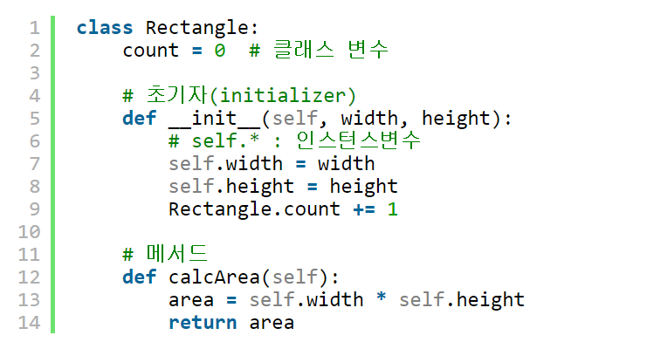
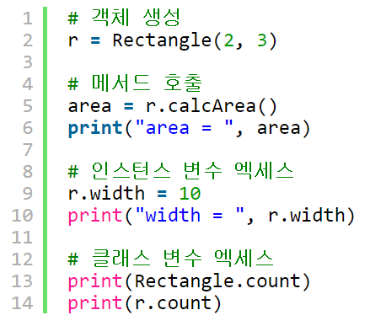
Object in Python Class
클래스를 사용하기 위해 객체(Object)를 생성해야 하며 "객체변수명 = 클래스명()"과 같이 클래스명을 함수 호출하는 것처럼 사용하면 된다.
To use a class, you first need to create an object from the class. To create an object in Python, use the class name as if you were calling a function like "object variable name = class name ()".
Class “Rectangle” is assigned to an object “r”
http://pythonstudy.xyz/python/article/

Slide 32
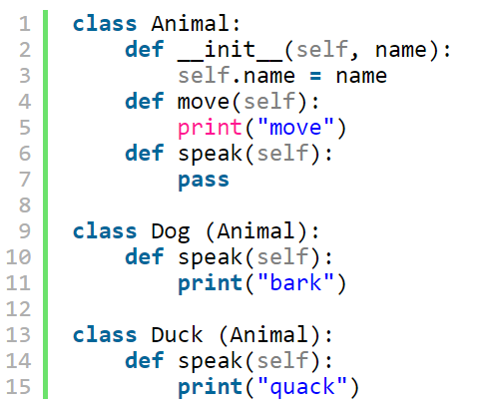
Inheritance of Class
(부모)클래스는 다른(자식) 클래스로 상속되며 상속 받기 위해서는 파생클래스(자식클래스)에서 클래스명 뒤에 베이스클래스(부모클래스) 이름을 괄호와 함께 넣어 주면 된다.
To inherit a class, you can put the base class (parent class) name in parentheses in the derived class (child class), followed by the class name.
Dog, Duck are child class that inherits the functions from parent class “Animal”
http://pythonstudy.xyz/python/article/

Slide 33
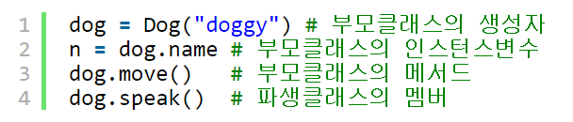
Inheritance of Class
자식클래스는 부모클래스의 멤버들을 호출하거나 사용할 수 있다
Child classes can call or use members of the parent class
http://pythonstudy.xyz/python/article/

Slide 34
Active learning : week 1
Python review
Python module, package, class coding practice
PyTorch review

Slide 35
1.0 Machine learning basic

Slide 36
AI, Machine learning, Deep learning
Artificial Intelligence: technique which enables computers to mimic human behavior
Machine learning: Subset of AI technique which uses statistical methods to enables machines to improve with experiences
Deep learning: Subset of ML which make the computation of multi-layer neural networks feasible
CNN
RL
RNN
LSTM
추천: Youtube 기계학습(Machine learning) 입문하기 강의, Terry TaeWoong Um

Slide 37

Types of Machine learning
Capstone design 2
Without label
Train with solution(label)
Regression
Clustering Classification, Regression
Sequential actions
Capstone design 2
[images from google]

Slide 38
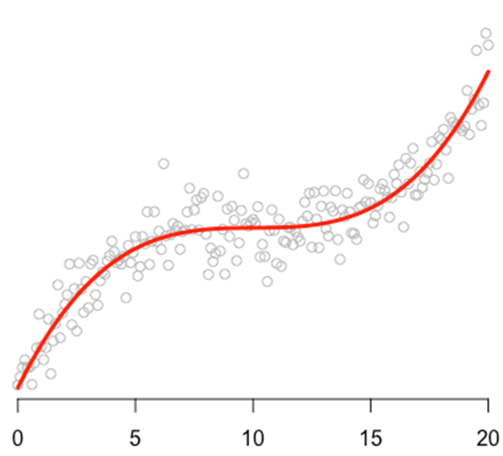
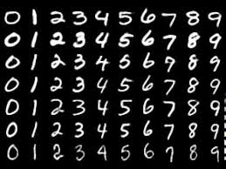
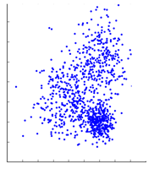
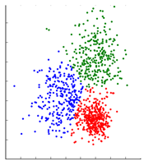
Machine learning (= evolving Regression)
A computer program is said to learn from experience E with respect to some class of task T and performance measure P, if its performance at task in T, as measured by P, improves with experience E. (Mitchell, 1997)
Task : classification, regression, clustering
Performance (loss function): errors, distance
Experience: data (labeled, unlabeled)
Rate of correct answers
Distance(=regression error) from model (y = f(x³))
Distance from lines (Supporting Vector Machine)
https://www.youtube.com/watch?v=j3za7nv7RfI, images from google

Slide 39
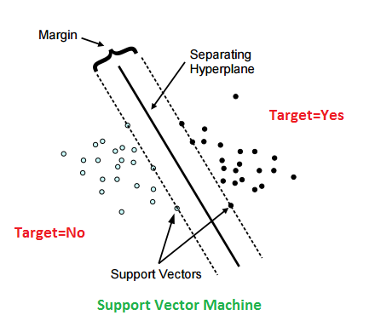
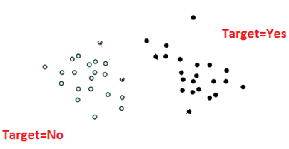
Classification algorithm (1 of many!)
Support vector machine (SVM) model is a representation of the examples as points in space, mapped so that the examples of the separate categories are divided by a clear gap that is as wide as possible.
Q: how to find supporting vectors?
Q: how to find a character(s) that separates the data for classification?
[images from google]

Slide 40
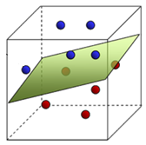
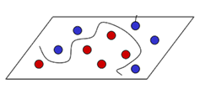
Feature
머신러닝에서 판별하고자 하는 데이터에 대해서 판별의 근거로 활용할 수 있는 데이터의 특징들을 feature라고 한다
In machine learning and pattern recognition, a feature is an individual measurable property or characteristic of a phenomenon being observed
Choosing informative, discriminating and independent features is a crucial step for effective algorithms in machine learning
Kernel function which enable the data in raw representation to operate in a high-dimensional, implicit “feature” space
Coordinate transfer,
i.e., Kernel function φ
Then find SVM = maximize the distance from separation lines(planes)
Input space
Feature space
[images from google]
Popular Kernel functions: Fisher kernel, Polynomial kernel, Radial basis function kernel (RBF), etc

Slide 41
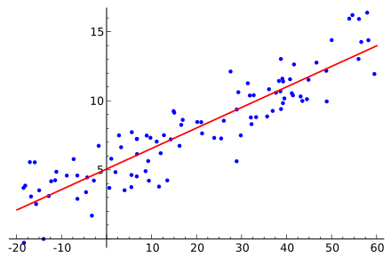
Mathematical formulation of regression
Model/feature (= regression function)
y_{i}
y_{θ}
Loss function (= cost function)
Mean Squared Error (MSE)
Optimization
Q: How to solve this?
[images from google]

Slide 42
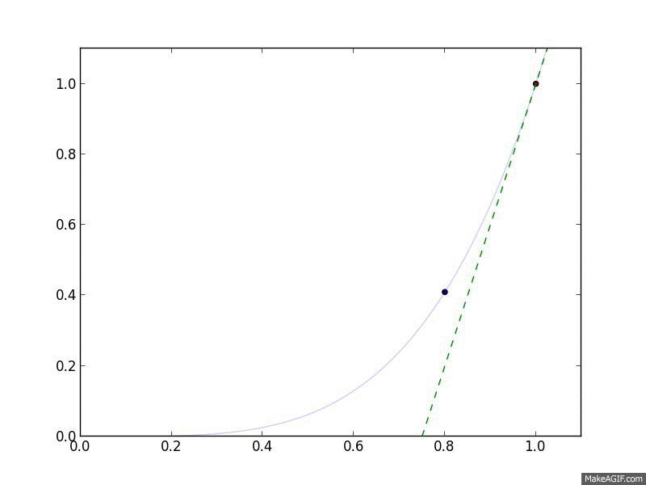
Finding min MSE by Gradient Descent
Gradient descent is a first-order iterative optimization algorithm for finding the minimum of a function. To find a local minimum of a function using gradient descent, one takes steps proportional to the negative of the gradient (or approximate gradient) of the function at the current point iteratively. [wiki]
배치(batch): 모델 학습의 반복 1회, 즉 경사 업데이트 1회에 사용되는 예(데이터)의 집합.
Batch: the set of examples used in one iteration (that is, one gradient update) of model training.
Q: If you have a VERY LARGE batch, even a single iteration may take a very long time to compute.
[images from google]

Slide 43
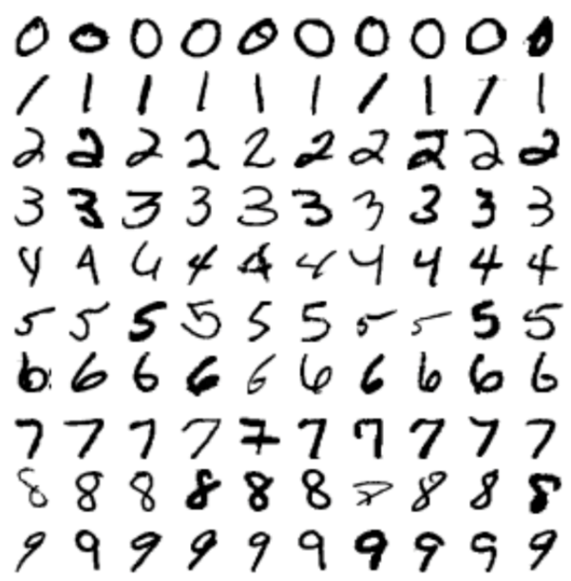
Stochastic gradient descent (SGD)
To minimize the loss function, a standard (or "batch") gradient descent method would perform the following iterations :
i^{th} observation (example) in the dataset of total size n used for training
Σ
A sample
A sample = instance = an observation = an input vector = a feature vector
When the training set is enormous and no simple formulas exist, evaluating the sums of gradients becomes very expensive, because evaluating the gradient requires evaluating all the summand functions' gradients.
[https://machinelearningmastery.com/difference-between-a-batch-and-an-epoch/ & Wikipedia]

Slide 44
Batch, Epoch
Epoch is an ENTIRE dataset passed through neural network only ONCE
Number of epochs defines the number times that the learning algorithm will work through the entire training dataset (sort of 재활용)
Since, one epoch is too big to feed to the computer at once we divide it in several smaller batches
Updating the weights using iterative GD with one epoch may be not enough
A batch
Batch Size: a number of samples processed before the model is updated
Tune it (BS) for training speed, model quality, computational power
[https://machinelearningmastery.com/difference-between-a-batch-and-an-epoch/ & Wikipedia]

Slide 45
Stochastic gradient descent (SGD)
Batch Gradient Descent: Batch Size = Size of Training Set
Stochastic Gradient (randomly select) Descent: Batch Size = 1
Pros: Faster calculation, Cons: May cause nosy results
Mini-Batch Gradient Descent: 1 < Batch Size < Size of Training Set
200
Ex) A dataset with 200 samples, a batch size = 5, epochs = 1,000
One epoch will involve 40 batches or 40 updates to the model
With 1,000 epochs, the model will pass through the whole dataset 1,000 times. That is a total of 40,000 batches during the entire training process
[https://machinelearningmastery.com/difference-between-a-batch-and-an-epoch/ & Wikipedia]

Slide 46
Stochastic gradient descent (SGD)
As the algorithm sweeps through the training set, it performs the above update for each training example. Several passes can be made over the training set until the algorithm converges.
If this is done, the data can be shuffled for each pass to prevent cycles.
Typical implementations may use an adaptive learning rate so that the algorithm converges.
Pseudocode
Choose an initial vector of parameters w and learning rate η
Repeat until an approximate minimum is obtained:
Randomly shuffle examples in the training set.
For i=1,2,...,n, do:
[https://machinelearningmastery.com/difference-between-a-batch-and-an-epoch/ & Wikipedia]

Slide 47
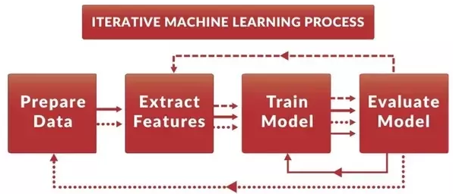
Machine learning process
Greater number of features, or even features with non-linear characteristics will make the regression process infeasible: Neural Net
Select a parametric/nonparametric model (linear, kernel etc.)
Set a performance measurement (loss function)
Training data (optimizing model parameter)
Evaluate the final performance using test data
Deep learning uses a cascade of multiple layers of nonlinear processing units for feature extraction and transformation.
Deep learning process
[images from google]

Slide 48
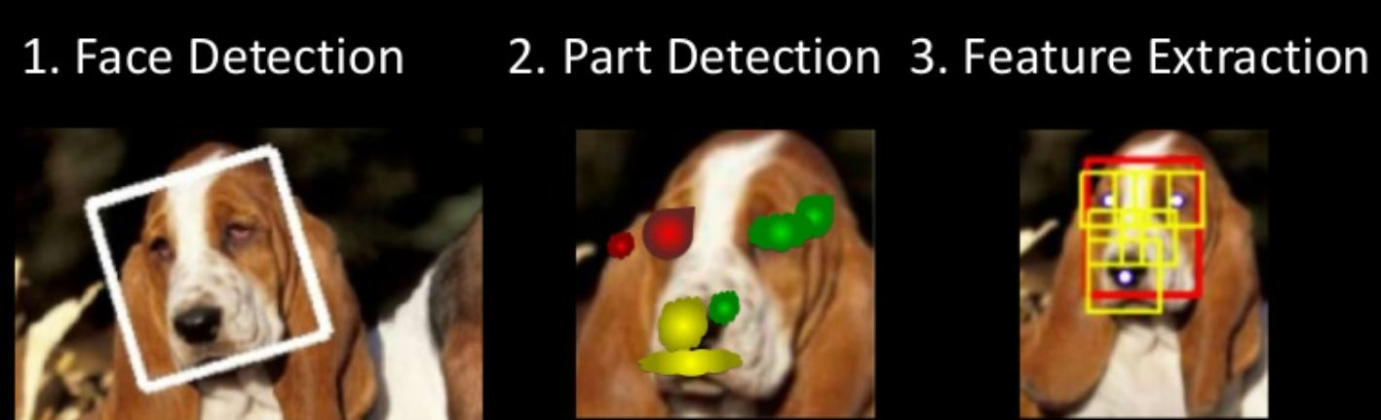
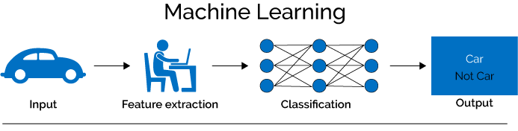
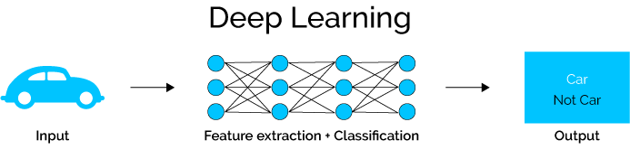
Deep learning
Feature learning, end-to-end learning
http://www.umiacs.umd.edu/~kanazawa/
https://medium.com/swlh/ill-tell-you-why-deep-learning-is-so-popular-and-in-demand-5aca72628780

Slide 49
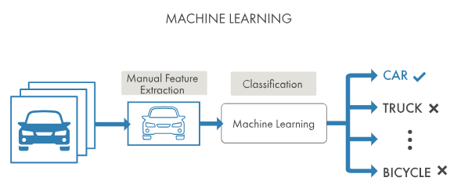
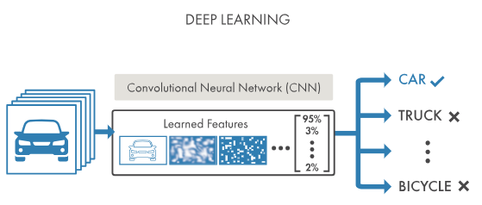
Machine learning vs. deep learning
In machine learning, you manually choose features and a classifier to sort images. With deep learning, feature extraction and modeling steps are automatic (so called, end-to-end learning).
A key advantage of deep learning networks is that they often continue to improve as the size of your data increases.
require MANY data, hard to debug
https://www.mathworks.com/discovery/deep-learning.html#withmatlab

Slide 50
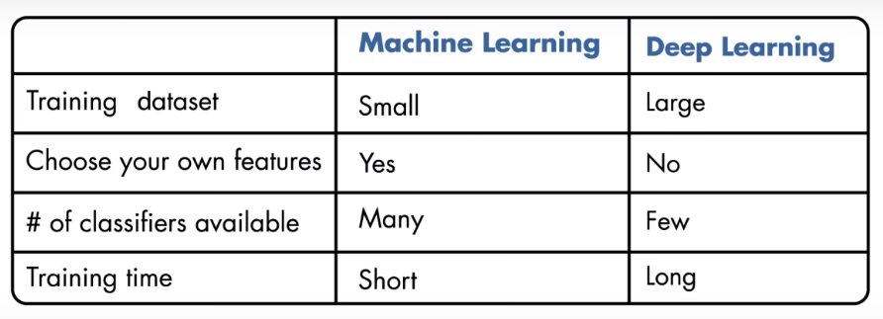
Machine learning vs. deep learning
From Matlab machine learning tutorial

Slide 51
In class review
RL: Reinforcement learning
AI
SVM:
support vector machine
Feature
ML: Machine learning
Regression/clustering/classification
Deep learning
SGD:
stochastic gradient descent
Kernel function
Supervised/unsupervised learning
NN:
Neural net
Loss function

Slide 52
Programming ML
Regression
Basic PyTorch programming

Slide 53
1.1 Neural Network

Slide 54
Machine learning
Try your own definition
θ₁
x₁
Σ
y₁
y_{θ}
θ₂
y_{i}
x₂
Σ
y₂
θi
x_{i}
Σ
y_{i}
b
x_{i}
Loss function (= cost function)
Mean Squared Error (MSE)

Slide 55
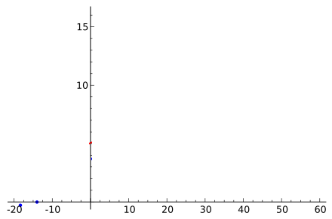
Machine learning ⸧ Neural network
θ₁
x₁
Σ
y₁
θ₂
y_{i}
x₂
Σ
y₂
θi
x_{i}
Σ
y_{i}
x_{i}
b
Loss function (= cost function)
Mean Squared Error (MSE)

Slide 56
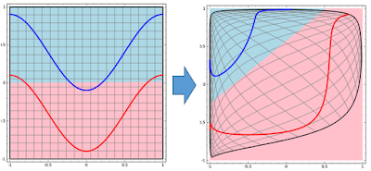
Neural Network
신경망이란 데이터를 잘 구분하기 위해 데이터 공간들을 잘 왜곡해 (e.g. kernels) 선들을 긋고 (e.g. SVM) 선형 맞춤 (linear fitting)과 비선형 변환 (nonlinear transformation or activation)을 반복하여 구분결과가 더 잘 나오게 하는 과정(optimization)을 포함하는 구조라고 할 수 있다
Neural networks are structures that are repeatedly built up with linear fitting and nonlinear transformation or activation to distinguish data
(사진출처: colah's blog)
파란선과 빨간선의 영역을 직선으로 구분한다고 하면 불완전한 구분이 되므로 (왼쪽), 공간을 왜곡하면 오른쪽과 같이 직선으로 구분가능하다
이처럼 인공신경망은 선 긋고, 구기고, 합하고를 반복하여 데이터를 처리한다
http://t-robotics.blogspot.com/2015/05/deep-learning.html#.W2ke9SgzY2w

Slide 57
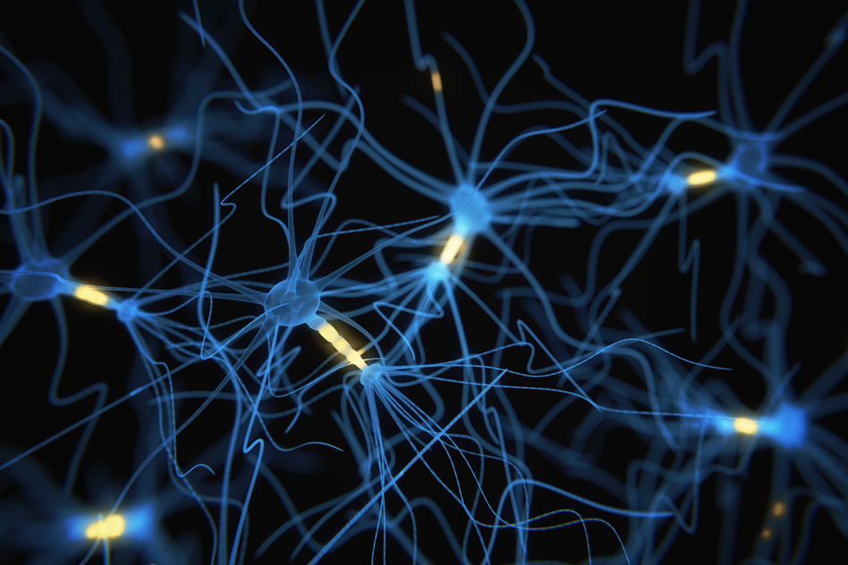
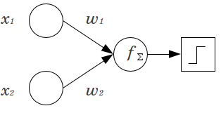
Perceptron: a basic unit of neural network
dendrite
w₁
soma
Activation function
Step function
Sigmoid(=logistic) function
ReLU
Softmax
Σsum
axon
w₂
Activation
Inputs
Weights
Sum
Activation function
Output
y
node
So an artificial neuron simply calculates a “weighted sum” of its input and then decides whether it should be “fired” or not ( = activation)
[images from google]

Slide 58
Multilayer perceptron
net
out
net2
out2
input
y₁
Σ
z₁
output
y₂
z₂
y₃
z₃

Slide 59
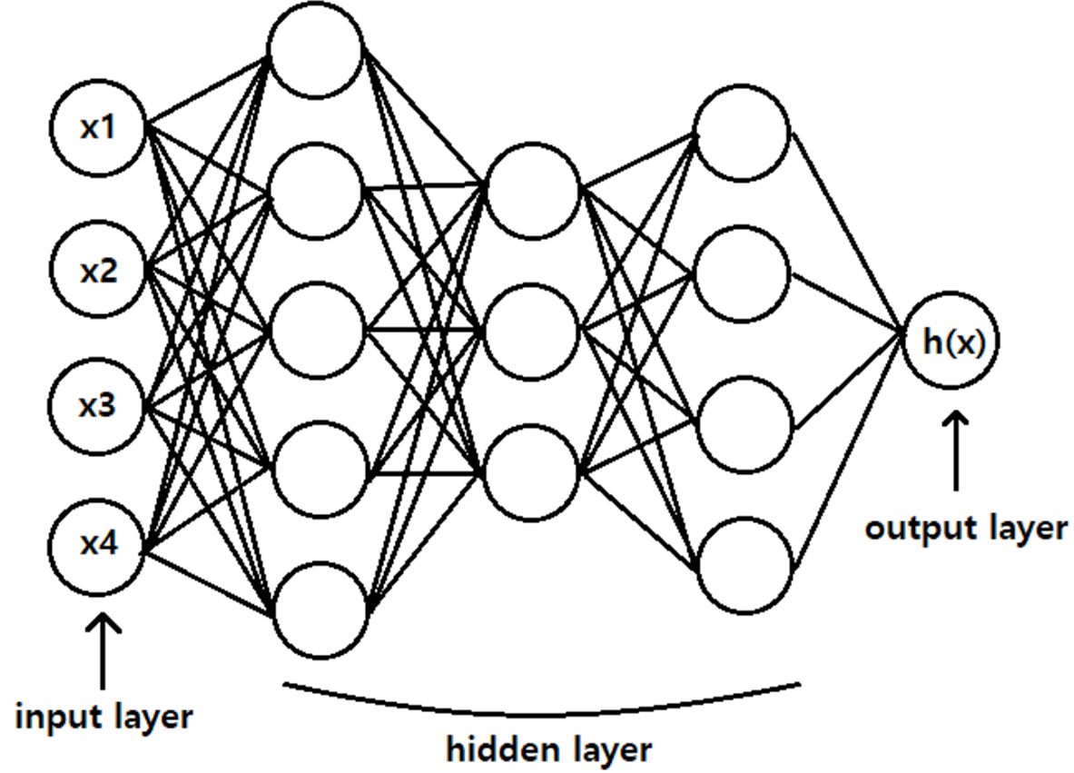
Multilayer perceptron
Fully connected
w₁₁
w₁₃
w₁₂
w_{n2}
w_{n3}
w_{n1}
Q: how to find w’s?
A: Tune ‘w’ to minimize the error btw. the true outputs and the estimated outputs ≡ loss function
[images from google]

Slide 60
Tune weight w to minimize the loss function
Recall, Gradient descent
Find x* such that min f(x*)
Backpropagation
Q: What is the loss function f(w)?
A: Error between the NN output & true values

Slide 61
Backpropagation
To tune ‘w’, starting from the outer most output, and progress backward
w₁₁
G
w_{n1}
w₁₂
w_{n2}
y
vs. y_{true}
w_{n3}
w_{n2}
w_{nn}
w_{n1}
Adjust “w” to minimize loss function f
Q: What is the loss function f(w)?
A: Error between the NN output & true values

Slide 62
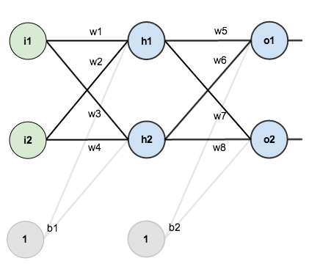
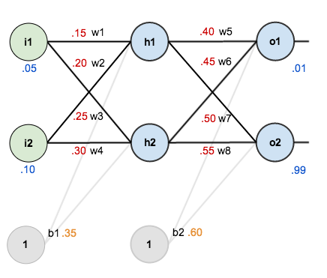
Backpropagation
Backpropagation is a method used to calculate a gradient of the loss function to adjust the weights of nodes in the network.
Ex) Here are the initial weights, the biases, and training inputs/outputs
Suppose using an activation function with logistic function
Given inputs 0.05 and 0.10
We want the neural network to output 0.01 and 0.99.
Q: Do you like initial guess?
A: i2, h2 weight should be greater
https://mattmazur.com/2015/03/17/a-step-by-step-backpropagation-example/

Slide 63
Backpropagation
Here’s how we calculate the total net input for h1:
net_{h1} = w1 * i1 + w2 * i2 + b1 * 1 = 0.15 * 0.05 + 0.2 * 0.1 + 0.35 * 1 = 0.3775
Using logistic function to get the output of h1:
Carrying out the same process for h2 we get: out_{h2} = 0.597
0.593
Repeat this process for the output layer neurons, using the output from the hidden layer neurons as inputs
+ (plus)
Activation function
0.597
https://mattmazur.com/2015/03/17/a-step-by-step-backpropagation-example/

Slide 64
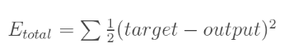
Backpropagation
Here’s the output for o1:
net_{o1} = w5 * out_{h1} + w6 * out_{h2} + b2 * 1 = 0.4 * 0.593 + 0.45 * 0.597 + 0.6 * 1 = 1.106
Similarly, out_{o2} = 0.773
Q: how to change w5?
Then calculate the loss function
0.593
0.751
0.01
0.597
0.773
Q: what affects to out_{o1}?
0.99
Q: Which output component contributes to error more?

Slide 65
Backward pass
Q: We want to know how much a change in w5 affects the total error?
w₅ affects to E_{total} through o₁ by network + activation function
0.751
E_{total}
0.773
out_{o1}

Slide 66
Backward pass
Finally, how much does the total net input of o1 change with respect to w5?
Recall, net_{o1} = w5 * out_{h1} + w6 * out_{h2} + b2 * 1
Putting all together

Slide 67
Backward pass
Update weight: to decrease the error, we then subtract this value from the current weight (optionally multiplied by some learning rate, eta, which we’ll set to 0.5):
Reduce weight w5 to reduce error (= loss function)
We can repeat this process to get the new weights w6, w7, and w8:
https://mattmazur.com/2015/03/17/a-step-by-step-backpropagation-example/

Slide 68
Hidden layer
Next, we’ll continue the backwards pass by calculating new values for w1, w2, w3, w4.
net
output
h1
E_{total}

Slide 69
Hidden layer
We can now update all of our weights w1, w2, w3, w4.
Reduce weight w1 (very slightly) to reduce error (= loss function)
Original network error E_{total} = 0.298
After the first round of backpropagation, E_{total} = 0.291
It seems to be very small change, but after training (repeating) this 10⁴ times (with different batches), for example, the error plummets to 0.0000351085.
https://mattmazur.com/2015/03/17/a-step-by-step-backpropagation-example/

Slide 70
Recall, Backpropagation
w_{n1}
w_{n2}
y
vs. y_{true}
w_{n3}
w_{nn}
Derivative of output errors
Output is a weighted sum of inputs with activation function
Images from google

Slide 71
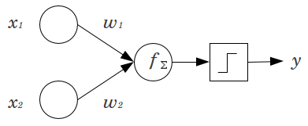
Activation function in NN
Inputs
Weights
Sum
Activation function
Output
y
vs. y_{true}
Activation function
Step function
Derivative of output errors
Output is a weighted sum of inputs with activation function
y
Images from google

Slide 72
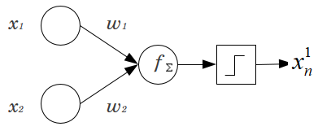
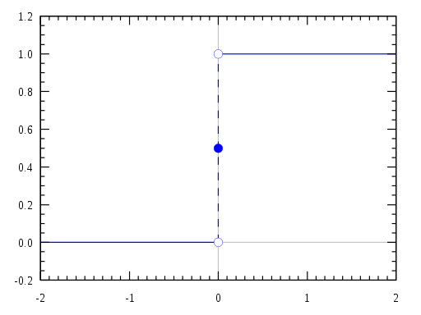
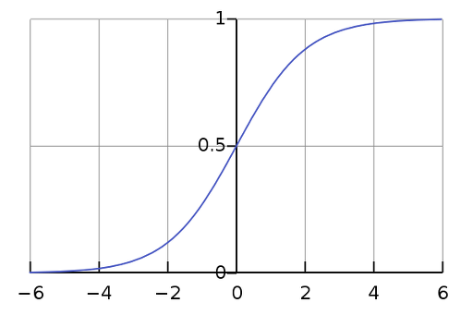

Activation function
Step function
σ( )
Bias
Activation function, e.g. logistic
Logistic function
To update the weight w, take a derivative of f, i.e., activation funciton
ReLU function
Update of the weight (~ proportional to the partial derivative ∇ of the error function) would not occur if the gradient will be vanishingly small. This may completely stop the neural network from further training.
⇒ ‘Vanishing gradient’ problem
Images from google

Slide 73
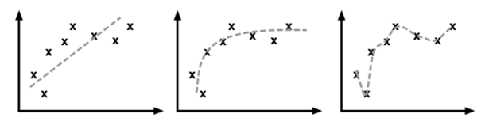
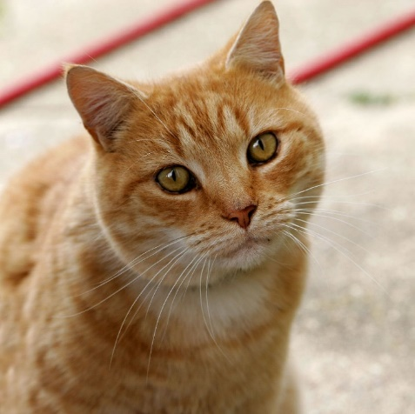
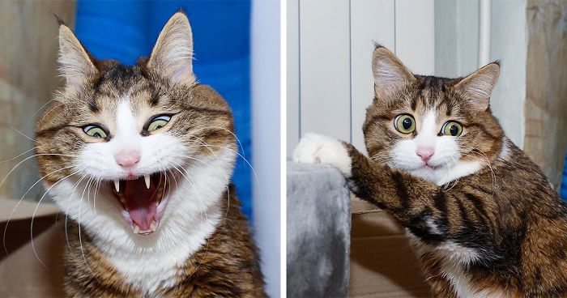
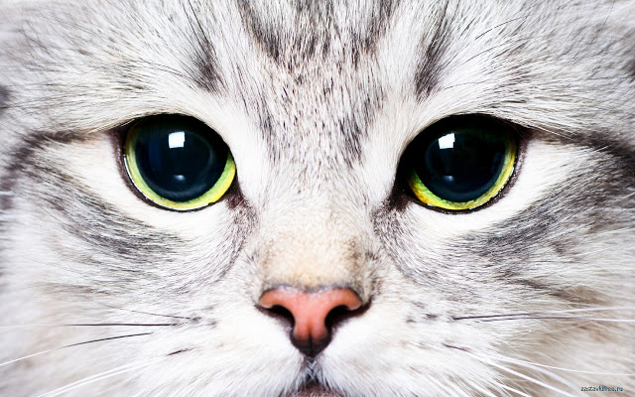
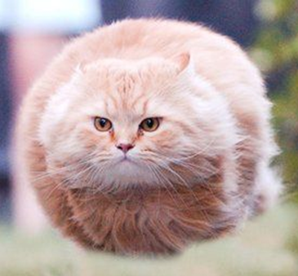
Overfitting with training images
Under fitting
Over fitting
Theses are not cats because it’s different from what has been trained
Q: How to avoid ‘overfitting’?

Slide 74
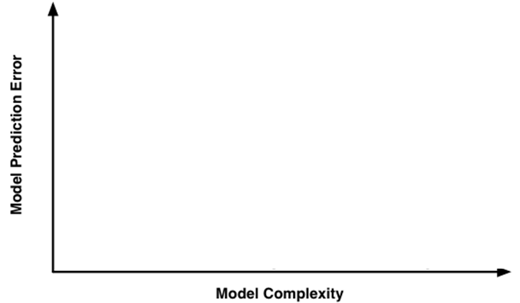
Training & test (,validation)
Under fitting
Over fitting
Data
Training set
Prediction Error for New data
Optimum model complexity
Validation set
Training error
https://www.quora.com/What-is-generalization-in-machine-learning

Slide 75
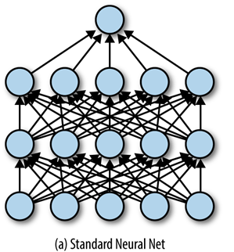
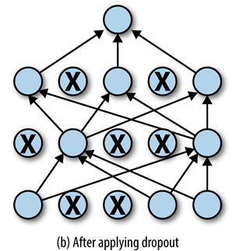
Dropout
Dropout is a form of regularization that randomly drops some proportion of the nodes that feed into a fully connected layer.
This helps prevent the net from relying on one node in the layer too much.
Here, dropping a node means that its contribution to the corresponding activation function is set to 0. Since there is no activation contribution, the gradients for dropped nodes drop to zero as well.
https://www.safaribooksonline.com/library/view/tensorflow-for-deep/9781491980446/ch04.html

Slide 76
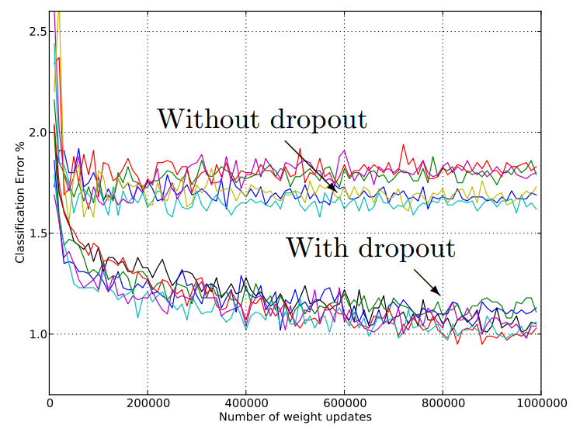
Dropout
Bellow we have a classification error (Not including loss), observe that the test/validation error is smaller using dropout
https://leonardoaraujosantos.gitbooks.io/artificial-inteligence/content/dropout_layer.html

Slide 77
In class review
Backpropagation
Hidden layer
Neural Network (ANN)
Overfitting
Dropout
ReLU
Softmax
SGD:
stochastic gradient descent
Fully connected
Vanishing gradient
Loss function

Slide 78
Programing NN
Basic code structures & details

Slide 79
1.2 Convolutional Neural Network

Slide 80
Convolution
Convolve 감다; 감기다; 휘감다; 둘둘 말다[감다]; 빙빙 돌다
Convolution
대단히 복잡한[난해한] 것 ex) the bizarre convolutions of the story
(나선형의) 주름[구불구불한 것] the convolutions of the brain
합성곱(convolution)은 하나의 함수와 또 다른 함수를 반전 이동한 값을 곱한 다음, 구간에 대해 적분하여 새로운 함수를 구하는 수학 연산자이다. a mathematical operation on two functions (f and g) to produce a third function that expresses how the shape of one is modified by the other

Slide 81
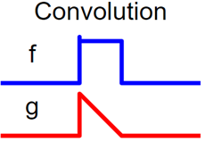





Convolution
Convolutional filter
[Wikipedia]

Slide 82

Convolutional neural network (CNN)
이미지 입력과 같은 경우 데이터량을 줄여 효율적으로 계산하기 위해 입력값에서 특징점(feature)을 추출하는 필터(convolutional filter)를 사용하여 입력 데이터를 스캔하여 feature map (=activation map)을 생성하는 신경망
A neural network method that scans input data using a convolutional filter that extracts feature points from the input values ​​to efficiently calculate the data amount in the case of image input.
Images from google

Slide 83

Artificial NN, i.e., fully connected NN
ReLu
input
weighted sum
activation
output
Instant
Classification of the instance
Hidden layers
Convolutional layers
to efficiently detect the patterns of the image
Fully connected, DEEP neural net
Images from google

Slide 84
Patterns of an image
0
0
0
0
1
0
0
0
0
0
0
1
1
0
0
0
0
…
1
Patterns
1
1
1
1
1
1
1
1
1
1
1

Slide 85



0
0
0
0
1
0
0
0
0
0
0
1
1
0
0
0
0
…
Patterns
x₅
1
x₁₃
x₁₈
Q: How to extract the pattern of complicated input?

Slide 86

Convolutional neural network
Combinations of edges, i.e., ear
Combinations of edges, i.e., face, … dog
Patterns i.e., edges
input
output
Instant
Classification of the instance
dog
cat
bird
…
Convolutional layers

Slide 87
Convolution filter
Input layer
Zero padding
Convolution layer 1
5
 |  |  | 1 | 1 | 1
 |  |  | 1
 |  |  | 1 | 1 | 1
 |  |  |  |  | 1
 |  |  |  |  | 1
 |  |  | 1 | 1 | 1
0
0
0
• product
• product
0.1 | 0.3 | 0.2
0.7 | 0.9 | 0.8
0.2 | 0.5 | 0.4
Convolutional filter

Slide 88
Ex) Convolution filter detecting edges
Input layer
Convolution layer 1
 |  |  | 1 | 1 | 1
 |  |  | 1
 |  |  | 1 | 1 | 1
 |  |  |  |  | 1
 |  |  |  |  | 1
 |  |  | 1 | 1 | 1
0 | 1 | 2 | 3 | 2 | 1 | 0 | 0
0 | 0 | -1 | -2 | -2 | -1 | 0 | 0
0 | 0 | 1 | 2 | 2 | 1 | 0 | 0
0 | -1 | -2 | -2 | -1 | 0 | 0 | 0
0 | 0 | 0 | 0 | 0 | 0 | 0 | 0
0 | 1 | 2 | 2 | 1 | 0 | 0 | 0
0 | -1 | -2 | -3 | -2 | -1 | 0 | 0
0 | 0 | 0 | 0 | 0 | 0 | 0 | 0
0 | 1 | 2 | 3 | 2 | 1 | 0 | 0
0 | 0 | -1 | -2 | -2 | -1 | 0 | 0
0 | 0 | 1 | 2 | 2 | 1 | 0 | 0
0 | -1 | -2 | -2 | -1 | 0 | 0 | 0
0 | 0 | 0 | 0 | 0 | 0 | 0 | 0
0 | 1 | 2 | 2 | 1 | 0 | 0 | 0
0 | -1 | -2 | -3 | -2 | -1 | 0 | 0
0 | 0 | 0 | 0 | 0 | 0 | 0 | 0
Highlights horizontal black edges
-1 | -1 | -1
1 | 1 | 1
0 | 0 | 0
Convolutional filter

Slide 89
Ex) Convolution filter detecting edges
Convolution layer 1
Convolution layer 2
0 | 1 | 2 | 3 | 2 | 1 | 0 | 0
0 | 0 | -1 | -2 | -2 | -1 | 0 | 0
0 | 0 | 1 | 2 | 2 | 1 | 0 | 0
0 | -1 | -2 | -2 | -1 | 0 | 0 | 0
0 | 0 | 0 | 0 | 0 | 0 | 0 | 0
0 | 1 | 2 | 2 | 1 | 0 | 0 | 0
0 | -1 | -2 | -3 | -2 | -1 | 0 | 0
0 | 0 | 0 | 0 | 0 | 0 | 0 | 0
-4 | -9 | -12 | -11 | -6 | -2 | 0 | 0
2 | 6 | 10 | 10 | 6 | 2 | 0 | 0
-4 | -8 | -10 | -8 | -4 | -1 | 0 | 0
3 | 5 | 5 | 3 | 1 | 0 | 0 | 0
3 | 5 | 5 | 3 | 1 | 0 | 0 | 0
-6 | -11 | -12 | -9 | -4 | -1 | 0 | 0
3 | 6 | 7 | 6 | 3 | 1 | 0 | 0
0 | 0 | 0 | 0 | 0 | 0 | 0 | 0
Highlights horizontal black edges
-1 | -1 | -1
1 | 1 | 1
0 | 0 | 0
Convolutional filter

Slide 90
Ex) Convolution filter detecting edges
Input layer
Convolution layer 1
 |  |  | 1 | 1 | 1
 |  |  | 1
 |  |  | 1 | 1 | 1
 |  |  |  |  | 1
 |  |  |  |  | 1
 |  |  | 1 | 1 | 1
0 | 0 | 2 | -1 | 0 | -1 | 0 | 0
0 | 0 | 3 | -1 | 0 | -2 | 0 | 0
0 | 0 | 2 | -1 | 1 | -2 | 0 | 0
0 | 0 | 1 | 0 | 2 | -3 | 0 | 0
0 | 0 | 1 | 0 | 2 | -3 | 0 | 0
0 | 0 | 1 | 0 | 1 | -2 | 0 | 0
0 | 0 | 1 | 0 | 0 | -1 | 0 | 0
0 | 0 | 0 | 0 | 0 | 0 | 0 | 0
-1 | 1 | 0
-1 | 1 | 0
-1 | 1 | 0
Convolutional filter 2

Slide 91
Patterns of the image
Apply multiple convolutional filters to extract feature map like edges
Patterns i.e., edges

Slide 92

Convolution filter
입력(이미지)으로 부터 여러가지 특징(예-테두리)을 추출하는 다중의 컨볼루션 필터를 적용
Apply multiple convolutional filters to extract feature map like edges
Stride size
Filter size
“eye” filter
“circle” filter
Ex) 위의 이미지를 파란 사각형 윈도우 (컨볼루션필터)로 rolling 하며 추출
Suppose you detect the image by viewing through a blue window

Slide 93


Ex) Convolution filter detecting features
Input layer
Convolution layer 2
Detect “circle” feature
Detect “corner” feature
https://www.youtube.com/playlist?list=PLZbbT5o_s2xq7LwI2y8_QtvuXZedL6tQU

Slide 94


Ex) Convolution filter detecting features
Input layer
Convolution layer 4
Detect “face” feature
https://www.youtube.com/playlist?list=PLZbbT5o_s2xq7LwI2y8_QtvuXZedL6tQU

Slide 95

Ex) Convolution with layered input (RGB)
Two convolution layers
http://cs231n.github.io/convolutional-networks/

Slide 96

Ex) Convolution with layered input
Two convolution layers
http://cs231n.github.io/convolutional-networks/

Slide 97
Recall, Artificial NN
ReLu
input
weighted sum
activation
output
Instant
Classification of the instance
Hidden layers
Images from google

Slide 98
Convolutional neural network
Convolutional layer
input
Filter
ReLu
weighted sum
ReLu
output
Instant
Classification
Filter
ReLu
Pool
Filter
ReLu
Pool

Slide 99
Convolutional neural network
Convolutional layer
Fully connected
input
Filter
ReLu
weighted sum
ReLu
output
Filter
ReLu
데이터 사이즈를 줄이기 위해 추출된 Activation map을 줄이는 것을 pooling (=sub sampling) 이라고 하고 인접샘플중 제일 큰 값을 선택하는 max pooling 이라는 기법이 많이 사용된다
Pooling is used to reduce the extracted activation map. A technique called max pooling which selects the largest value among adjacent samples is commonly used
Pool
Filter
ReLu
Pool

Slide 100
Max pooling example
Filter size = 2
Stride size = 2
Input layer
Convolution layer 1
1 | 3 | 2 | 0
0 | 2 | 2 | 0
1 | 2 | 1 | 0
0 | 0 | 0 | 0
 |  |  | 1 | 1 | 1
 |  |  | 1
 |  |  | 1 | 1 | 1
 |  |  |  |  | 1
 |  |  |  |  | 1
 |  |  | 1 | 1 | 1
0 | 1 | 2 | 3 | 2 | 1 | 0 | 0
0 | 0 | -1 | -2 | -2 | -1 | 0 | 0
0 | 0 | 1 | 2 | 2 | 1 | 0 | 0
0 | -1 | -2 | -2 | -1 | 0 | 0 | 0
0 | 0 | 0 | 0 | 0 | 0 | 0 | 0
0 | 1 | 2 | 2 | 1 | 0 | 0 | 0
0 | -1 | -2 | -3 | -2 | -1 | 0 | 0
0 | 0 | 0 | 0 | 0 | 0 | 0 | 0
1 | 3 | 2 | 0
0 | 2 | 2 | 0
1 | 2 | 1 | 0
0 | 0 | 0 | 0
Highlights horizontal black edges
-1 | -1 | -1
1 | 1 | 1
0 | 0 | 0
Convolutional filter

Slide 101

CNN example
추천: https://www.slideshare.net/yongho/ss-79607172, 자습해도 모르겠던 딥러닝, 머리속에 인스톨 시켜드립니다, 하용호
http://goodtogreate.tistory.com/entry/Convolutional-Neural-Network-CNN

Slide 102

CNN example
http://cs231n.stanford.edu/

Slide 103

CNN example
http://cs231n.stanford.edu/

Slide 104
Programing CNN
[import & setting parameters]
[Visualize a few images]
[Train the model]
loss.backward()
optimzer.step()
[Visualize the model prediction]
[Fine tune the convolution net]
optim.SGD(model_ft.parameters(), lr = 0.001, momentum = 0.9)
[Train & evaluate]

Slide 105
2.0 SLAM basic

Slide 106
2.1 SLAM package in ROS

Slide 107
2.2 SLAM for Capstone project

Slide 108
Recall,
Backpropagation
Hidden layer
Convolutional Neural Network (CNN)
Overfitting
Maxpooling
Dropout
ReLU
Softmax
Feature
SGD:
stochastic gradient descent
Vanishing gradient
Fully connected NN
Loss function

Slide 109
Recall,
RL: Reinforcement learning
AI
ML: Machine learning
Regression/clustering/classification
Deep learning
Supervised/unsupervised learning
NN:
Neural net

Slide 110
3.0 Reinforcement learning Deep Q-learning Network
모두를 위한 RL 강좌 by Sung Kim, https://www.youtube.com/playlist?list=PLlMkM4tgfjnKsCWav-Z2F-MMFRx-2gMGG

Slide 111
Types of Machine learning
Capstone design 2
Without label
Train with solution(label)
Regression
Clustering Classification, Regression
Sequential actions
Capstone design 2
[images from google]

Slide 112
Types of Machine learning
Capstone design 2
Without label
Train with solution(label)
Regression
Clustering Classification, Regression
Sequential actions
Capstone design 2
[images from google]

Slide 113

Reinforcement learning
https://www.krigolsonteaching.com/reinforcement-learning.html

Slide 114

Reinforcement learning in AI
Computational approach to learning from interaction
Reinforcement learning (RL) is an area of machine learning concerned with how software agents ought to take actions in an environment so as to maximize some notion of cumulative reward. [wiki]
https://becominghuman.ai/the-very-basics-of-reinforcement-learning-154f28a79071

Slide 115

Atari Breakout Game by Google Deepmind
https://www.youtube.com/watch?v=V1eYniJ0Rnk

Slide 116

Reinforcement learning in OpenAI Gym
OpenAI is a non-profit research company that is focussed on building out AI in a way that is good for everybody. It was founded by Elon Musk and Sam Altman.
OpenAI Gym is a toolkit for developing and comparing reinforcement learning algorithms
“A 2016 Nature survey indicated that more than 70 percent of researchers have tried and failed to reproduce another scientist’s experiments, and more than half have failed to reproduce their own experiments.”
OpenAI is created for removing this problem of lack of standardization in papers along with an aim to create better benchmarks by giving versatile numbers of environment with great ease of setting up.
Aim of this tool is to increase reproducibility in the field of AI and provide tools with which everyone can learn about basics of AI.
https://towardsdatascience.com/reinforcement-learning-with-openai-d445c2c687d2

Slide 117


OpenAI Gym ex) cart-pole
import gym
env = gym.make('CartPole-v0')
env.reset()
for _ in range(1000):
env.render()
env.step(env.action_space.sample()) # take a random action
import gym
env = gym.make('CartPole-v0')
for i_episode in range(20):
observation = env.reset()
for t in range(100):
env.render()
print(observation)
action = env.action_space.sample()
observation, reward, done, info = env.step(action)
if done:
print("Episode finished after {} timesteps".format(t+1))
break
→화면출력
→ 입력(화면)에 대해 취할 액션,창시구 2에서는 공 화면이 입력(화면)이 되고 모터로 보내는 명령이 액션임
done: 게임 종료
※Controlling an inverted pendulum w/ vs. without domain knowledge
https://gym.openai.com/docs/

Slide 118



OpenAI Gym ex) Frozen lake
State
2
0
1
Action (right, left, up, down)
State, reward
Reward 1
[S] safe/start
[F] frozen
[H] hole
[G] goal
https://towardsdatascience.com/reinforcement-learning-with-openai-d445c2c687d2

Slide 119
OpenAI Gym ex) Frozen lake
When playing game, you don’t know what’s the state & reward until you take an action
0
1
Action (right)
State(1), reward(0)
[S] safe/start
[F] frozen
[H] hole
[G] goal
https://towardsdatascience.com/reinforcement-learning-with-openai-d445c2c687d2

Slide 120

Lookup table method: Q(quality)-table
Mission: (quickly) pick the blue ball, then get reward (+1)
Suppose the wheels could go right, left, up, down (4 actions)
Suppose red balls are bombs
Start
When playing game, you don’t know what’s the state & reward until you take an action
모두를 위한 머신러닝 강의 https://hunkim.github.io/ml/

Slide 121
Q-learning (look-up table)
Initially, vehicle don’t know which is where
So just randomly take an action and then get the information about the states and reward
Start
a
a
s1
s2
r = 0
Mostly, you don’t get the feedback for your action, so r = 0
If you reache to the hole, game is over
a
You get the reward (not for each action but) for the “whole action set”
s
If you reache to the goal, get a reward 1
a
Q1: What if you have a something (or someone) to ask where to go?
s
r = 1
모두를 위한 머신러닝 강의 https://hunkim.github.io/ml/

Slide 122
Q function : State-action-value function
Suppose a Q gives you the feedback about the reward “r” you would get when you take an action “a” at the state “s”
Q
Start
a
a
Q
Q
s1
s2
s
r
r =0
r =0
a
function Q(state, action) = reward
모두를 위한 머신러닝 강의 https://hunkim.github.io/ml/

Slide 123
Select action from Q function
Suppose you trust Q and take an action “a” that maximize the reward “r”
Start
Q
s1
Q(state, action) = reward
Q(s1, left) = 0
Q(s1, right) = 0.5
Q(s1, up) = 0
Q(s1, down) = 0.3
① Choose this to maximize the Q in response to various a,
② Then take a corresponding action, i.e. “right”
Policy
Optimal policy
모두를 위한 머신러닝 강의 https://hunkim.github.io/ml/

Slide 124
How to find(know) Q?
Suppose you follow the advice of Q ( = optimal policy) at each state “s” and take an action “a” that maximize the reward “r”
Start
a
a
Q₀
s1
Q₁
Q₂
s2
r
r
a’
r
s'
Q’(s’,a’)
Q: What is relationship between Q’s?
Suppose you know Q’(s’,a’), how to obtain Q(s,a)?
s’ is the state reached by an action “a” from the previous state “s”
모두를 위한 머신러닝 강의 https://hunkim.github.io/ml/

Slide 125
How to find(know) Q?
Start
a
a
-or- different explanation
Q₀
s1
Q₁
Q₂
s2
State (s) → action (a) → reward (r)
r
r
s₀, a₀, r₁, s₁, a₁, r₂, s₂, …, s_{n-1}, a_{n-1}, r_{n}, s_{n}
a’
r
s'
Q’(s’,a’)
Total reward R
Then optimal R_{t} could be obtained as follows
*
max
a
^
^
^
Update Q this way until you get the optimal Q*
모두를 위한 머신러닝 강의 https://hunkim.github.io/ml/

Slide 126
Ex) Learning Q
16 states and 4 actions (up, down, left, right)
Start
Initial Q values are 0
0
0
0
0
0
0
0
0
0
0
0
0
0
0
0
0

Slide 127
Ex) Learning Q
Q(s₀,a_{right})
← r + max Q(s₁,a’) = 0 + 0
Initial Q values are 0
Q
0
s₁
a
0
s₂
a
0
0
0
0
Q
0
0
Q
0
0
0
0
0
0
0
r=0
0
r=0
0
0
Q(s₁,a_{right})
← r + max Q(s₂,a’) = 0 + 0
Q₁₃(s₁₃,a_{right}) ← r + max Q₁₄(s₁₄,a’) = 0 + 1 = 1
Q
s₁₃
a
Q
s₁₄
a
0
1
1
0
Q
0
r=0
r=1
0
Q₁₄(s₁₄,a_{right})
← r + max Q₁₅(s₁₅,a’) = 1 + 0 = 1

Slide 128
Ex) Learning Q
Initial Q values are 0
0
0
0
0
0
0
0
0
0
0
0
0
0
0
0
0
0
0
1
1

Slide 129
Ex) Learning Q table after one success
Update the Q’s for many visits
1
1
1
Optimal “policy” π* is obtained by taking a series of actions that maximize Qs
1
1
1
1
1

Slide 130
Programming Q-learning algorithm
Initialize a Q table (Set the size of the Q, etc.)
Start with a state s
For loop
Select an action a
Execute action a and receive immediate reward r
Go to a new state s’
Update the Q table as follows
Replace the current state s to a new state s’
By repeating this, Q learning occurs

Slide 131
Exploit & exploration | ε-greedy
Q: Do you satisfy with the below “optimal” policy?
1
1
1
1
1
1
1
1

Slide 132
Exploit & exploration | ε-greedy
Q: Do you satisfy with the below “optimal” policy?
A: How about we try “random” action for the portion of ε % of total trials?
1
1
1
1
1
1
Also, decaying e-greedy, add random noise, etc
1
1
1
1

Slide 133
Discounted future reward
γ
Introduce a discount rate γ btw. [0,1] s.t.
-or- different approaches as a Discounted future reward
γ γ² γ^{n-t}
1
1
1
1
1
1
Choose the action that maximizes the (discounted) future reward
1
1
Q: Which path (policy) is better?

Slide 134
Ex) Discounted reward γ = 0.9
Choose the action that maximizes the (discounted) future reward
XX
0.73
XX
0.9
Q = 0 + γ³ ∙ max(0,0,0,1) = 0.73
Q = 0 + γ ∙ max(0,0,0,1) = 0.9
Q = 0 + γ² ∙ max(0,0,0,1) = 0.81
a
r=0
a
r=0
a
a
0
Q = 0 + γ ∙ max(0,0,0,1) = 0.9
0
0
r=0
r=1
0
Q = 1 + 0 = 1

Slide 135
Programming Q-learning algorithm
Initialize a Q table (Set the size of the Q, etc.)
Start with a state s
For loop
Select an action a
with ε-greedy
Execute action a and receive immediate reward r
Go to a new state s’
Discounted future reward
Update the Q table as follows
γ
※ Q^ converges to Q
Replace the current state s to a new state s’
Q: What if the response to action is different from what you expected?

Slide 136
Q table: e-greedy, discount rate
Initial Qs = 0
Initial action guess: R-D-D
Next action on argmax
0
1
0
0
1
0
1
1
1
Initial action guess: D-D-R
1
Next action on argmax
1
1
1
1
1
Initial action guess: R-D-L-D-R
Which one works better?

Slide 137


Slippery or rough surface
‘Right’ action may result in ‘Down’ or stay or others not intended to do so
⇒ Stochastic ( = Non-deterministic) world
s'
Q: Would you trust Q(left)?
1
This Q (s, left) = 1 may be obtained from trial of
Q (s, down (but slip to left))
0
⇒ Trust Q(s’) just a little bit and update Q(s) a little bit (learning rate)

Slide 138
Learning with learning rate α
Recall, update Q(s) from next state s’ information
If you partially trust states Q(s’), and stick to the current Q(s), then
(1− α)
α
α : Learning rate
s
s'
a
Q
1
r
0

Slide 139
Programming Q-learning algorithm
Initialize a Q table (Set the size of the Q, etc.)
Start with a state s
For loop
Select an action a with ε-greedy
Execute action a and receive immediate reward r
Go to a new state s’
Learning rate
Update the Q table as follows
Replace the current state s to a new state s’
※ Q^ converges to Q
Lab: http://computingkoreanlab.com/app/jAI/jQLearning/
Q: What if number of states are VERY big?

Slide 140
Update the Q in Q-table

Slide 141

Q-Table for AlphaGo
~10¹⁷¹
=208,1681,9938,1979,9846,9947,8633,3448,6277,0286,5224,5388,4530,5484,2563,9456,8209,2741,9612,7380,1537,8525,6484,5169,8519,6439,0725,9916,0156,2812,8546,0898,8831,4427,1297,1531,9317,5577,3662,0397,2470,6484,0935
⇒ Try Network!
⇒ Try ‘updated (~learning) regression (~network) ’ that gives greatest reward!
Images from google

Slide 142

Q-Table for AlphaGo
⇒ Network (~Regression)
s
Q
r
a
function Q(state, action) = reward
Previously Q-table:
@ state (s), and action (a), returns reward (r)
Images from google

Slide 143

Q function approximation using Network
Network of inputs of state ‘s’ & action ‘a’ and output as reward ‘r’
s
r
Reward for the given action, e.g., r_{LEFT}: 0.5
a
instead of building a (huge) Q-table
establish a regression (network) that returns reward
and update this to approximate the greatest reward (=optimal)!
http://cs231n.github.io/neural-networks-1/

Slide 144
Q function approximation using Network
Network of inputs of state ‘s’ and output as reward ‘r’ @ action ‘a’
Q₁
a
s
Reward (Q) for
all actions,
e.g., [0.5, 0.1, 0, 0.8]
r
Q₂
LEFT: 0.5
Right: 0.1
UP: 0
DOWN: 0.8
Q₃
Q Network
Q’s for all action

Slide 145
Q-Network training
We want output of Q-network W∙s to match with Q*(=y, label)
s
W∙s
~ Q*
(Suppose Q* exist at this point)
Equivalent to
linear regression problem
Weight (w) matrix : W
Formulate linear regression of finding “W” to match Wx ~ Q*(=y, label)

Slide 146

Q-Network training
Formulate linear regression of finding “W” to match Wx ~ Q*(=y, label)
Q prediction (^) at a given state ‘s’ and action ‘a’, as a function of weight (θ) of the network
Through the network, find weight (θ) to minimize the cost, i.e., loss
Function of weight (θ), from Network Ws= Θs
Approximation from next state’s Q_{s’} function and optimization
(note max Q’)
Also function of “θ”
Q: How do I know Q* that Q^ want to resemble?

Slide 147
Programming Q-Table learning algorithm
Initialize a Q table (Set the size of the Q, etc.)
Start with a state s
For loop
Select an action a with ε-greedy
Execute action a and receive immediate reward r
Go to a new state s’
Update the Q table as follows
Replace the current state s to a new state s’

Slide 148

Programming Q-learning algorithm
Q function with random weight θ₀
Initialize a Q table (Set the size of the Q, etc.)
Start with a state s
Initialize s₁ = {x₁}
-or- preprocessed(mostly images) sequenced φ₁ = φ(s₁)
Ex) x1 = state to motor command “forward”, then φ₁ = φ(s₁) is the changed image with respect to forward movement
φ(s₁)
φ(s₂)
φ(s₃)

Slide 149
Recall, e-greedy
Initialize a Q function with random weight θ₀
Initialize s₁ = {x₁} -or- preprocessed sequenced φ₁ = φ(s₁)
For loop
Select an action a with ε-greedy

Slide 150
Programming Q-learning algorithm
Initialize a Q function with random weight θ₀
Initialize s₁ = {x₁} -or- preprocessed sequenced φ₁ = φ(s₁)
For loop
= SIMULATOR
Select an action a with ε-greedy
Execute action ‘a’ in EMULATOR and observe the image x_{t+1} and reward
Execute action a and receive immediate reward r
Go to a new state s’
set s_{t+1} = {x_{t+1}}, or φ_{t+1} = φ(s_{t+1})(= here s_{t+1} )
Update the Q table as follows
Q(=Ws=θs) to match the target y using gradient descent
Ws
Target, label
Note, update Q* (the target), not the θ . Then find θ by optimization (gradient descent, minimize error)

Slide 151
Ex)
θ_{initial} i.e, W_{initial}
0.001
0.01
Q=0
0.03
vs. y=0.01
0.95
0.01
Q=0
Q=0
0.97
Q=0
0.03
Q=0.01
0.01
Q=0
Q=0
Q=1
Q=0.01

Slide 152
Programming Q-learning algorithm
Initialize a Q function with random weight θ₀
For loop for episodes
Initialize s₁ = {x₁} -or- preprocessed sequenced φ₁ = φ(s₁)
For loop
Select an action a with ε-greedy
Execute action a in emulator and observe the image x_{t+1} and reward
Go to a new set s_{t+1} = {x_{t+1}}, or φ_{t+1} = φ(s_{t+1})(= here s_{t+1} )
Update the Q(=Ws=θs) to match the target y using gradient descent
Q: Update “y” which is a function of “θ”
Key algorithm of Deep Learning used for Atari by Google DeepMind

Slide 153

Convergence
^
Q converges to Q* using table lookup representation BUT
^
Q diverges using neural networks due to
Correlations between samples
Non-stationary targets
Q: How DeepMind resolve this issue?
Go deep
Capture and Replay (sol’n for ①)
Separated networks: create a target network (sol’n for ②)
Images from google

Slide 154

DQN
DQN paper
www.nature.com/articles/nature14236
DQN source code
sites.google.com/a/deepmind.com/dqn/

Slide 155
Two issues to overcome
^
Q diverges using neural networks due to
Correlations between samples
Non-stationary targets

Slide 156
1. Correlation between samples
Initialize a Q function with random weight θ₀
For loop for episodes
Initialize s₁ = {x₁} -or- preprocessed sequenced φ₁ = φ(s₁)
For loop
Select an action a with ε-greedy, random or
Execute action a in emulator and observe the image x_{t+1} and reward
Go to a new set s_{t+1} = {x_{t+1}}, or φ_{t+1} = φ(s_{t+1})(= here s_{t+1} )
Update the Q(=Ws=θs) to match the target y using gradient descent
φ(s₁)
φ(s₂)
φ(s₃)
Very similar samples and correlated with each other

Slide 157

1. Correlation between samples
If samples have high correlation, the regression results could be biased
Biased regression
Biased regression
Reasonable linear fit
Suppose we train the Network using these correlated samples
※ Solution: Experience replay, i.e., random sample & replay
https://hunkim.github.io/ml/

Slide 158
1. Experience replay
Capture few samples (to reduce the intra-sample correlation), and perform a regression, and replay the “captured sample”
Random sample #1
Random sample #2
https://hunkim.github.io/ml/

Slide 159
1. Experience replay
Capture few samples (to reduce the intra-sample correlation), and perform a regression, and replay the “captured sample”
Stored in a buffer
Capture many samples
s₁, a₁, r₂, s₂
s₂, a₂, r₃, s₃
s₃, a₃, r₄, s₄
…
s_{t}, a_{t}, r_{t+1}, s_{t+1}
Random sample & replay for training
https://hunkim.github.io/ml/

Slide 160
Programming: experience replay
Initialize a Q function with random weight θ₀
For loop for episodes
Initialize s₁ = {x₁} -or- preprocessed sequenced φ₁ = φ(s₁)
For loop
Select an action a with ε-greedy, random or
Execute action a in emulator and observe the image x_{t+1} and reward
Go to a new set s_{t+1} = {x_{t+1}}, or φ_{t+1} = φ(s_{t+1})(= here s_{t+1} )
Store transition (φ_{t}, a_{t}, r_{t}, φ_{t+1}) in D (buffer)
Sample random minibatch of transitions (φ_{j}, a_{j}, r_{j}, φ_{j+1}) from D
Update the Q(=Ws=θs) to match the target y using gradient descent
160

Slide 161
2. Non-stationary target
Moving
Note, both learning parameter θ(=W), which is updated through the network, is also affect the target
Q prediction = Ws
Target(y) to match
※ Solution: Separate networks by creating a target network
⇒ Separate target network
^
And only update θ in Q

Slide 162
2. Separate target network
θ
s
W∙s
θ network
Copy θ every C steps
θ
s
θ network
Y (target)

Slide 163
2. Separate target network
Prediction Q is obtained from θ network
Update the Q(=Ws=θs) to match the target y using gradient descent
Update θ by gradient descent but no update for y
Target y is obtained from θ network
Every C steps, reset Q = Q
θ
s
W∙s
θ network
θ
s
θ network
Y (target)

Slide 164
Programming: experience replay
^
^
Initialize two networks of Q/Q functions with random weight θ₀ = θ₀
For loop for episodes
Initialize s₁ = {x₁} -or- preprocessed sequenced φ₁ = φ(s₁)
For loop (state j)
Select an action a with ε-greedy, random or
Execute action a in emulator and observe the image x_{j+1} and reward
Go to a new set s_{j+1} = {x_{j+1}}, or φ_{j+1} = φ(s_{j+1})(= here s_{j+1} )
Store transition (φ_{j}(= s_{j+1})), a_{j}, r_{j}, φ_{j+1}) in D
Sample random minibatch of transitions (φ_{j}, a_{j}, r_{j}, φ_{j+1}) from D
Update the Q(=Ws=θs) to match the target y using gradient descent
θ
θ
^
Every C steps, reset Q = Q
164

Slide 165

and Go Deep
DEEP neural net
Images from google

Slide 166
DQN programming
10/29: 기본적인 DQN 작동 원리와 시뮬레이터(Emulator) 코드 설명
11/5: 주어진 DQN 네트워크 구조 설명 및 학습, 코드 리뷰
11/12: 학습 파라미터 디테일 and Q&A
11/19: DQN/ROS Q&A Session
11/26: Capstone project demo Q&A Session

Slide 167


Slide 168
(FC)NN-CNN-DQN review

Slide 169
Recall, multiple perceptron
Fully connected
w₁₁
w₁₃
CNN : extract features from the original image to feed into the FC neural net
w₁₂
w_{n2}
w_{n3}
w_{n1}
DQN : set target from Q network
Q: how to find w’s?
Derivative of output errors (i.e. loss function) backward (backpropagation),i.e., Stochastic Gradient Descent
[images from google]

Slide 170

FC network – CNN - DQN
Depending on the convolution filter size (ex. ResNet 152), flattened input neuron size could vary
Other actions like directions, speeds could be tried
CNN is also applicable to text, sound inputs etc .
Fully connected network
Often image (RGB)
8
eight
right
Dog
output
Conv
+ ReLu
Conv
+ ReLu
Max
Pooling
Hidden layers
Input
CNN : extract features from the original image to feed into the FC network
flattened
Q: How to determine the motor “action” to input image?
A: Update y_{target} from Q-function based neural net, DQN

Slide 171

FC network programming- TensorFlow
# Loss function
hypothesis = tf.matmul(X, W) + b
cost = tf.reduce_mean(tf.square(hypothesis - Y))
# Minimize
optimizer = tf.train.GradientDescentOptimizer(learning_rate=1e-5)
train = optimizer.minimize(cost)
# initialize
sess = tf.Session()
sess.run(tf.global_variables_initializer())
# train my model
for step in range(training_epochs):
…
sess.run(train)
https://hunkim.github.io/ml/

Slide 172
FC network programming- PyTorch
Class (model=) Net(nn.Module):
...
self.fc1 = nn.Linear(28*28, 50)
self.fc1_drop = nn.Dropout(0.2)
self.fc2 = nn.Linear(50, 50)
self.fc2_drop = nn.Dropout(0.2)
self.fc3 = nn.Linear(50, 10)
...
x = x.view(-1, 28*28)
x = F.relu(self.fc1(x))
x = self.fc1_drop(x)
x = F.relu(self.fc2(x))
x = self.fc2_drop(x)
return F.log_softmax(self.fc3(x))
...
optimizer = optim.SGD(...)
def train(epoch, log_interval=100):
...
optimizer.zero_grad()
output = model(data)
loss = F.nll_loss(output, target) #import torch.nn.functional as F
loss.backward()
optimizer.step()
train(epoch)
https://github.com/leeJaeDuck/deeplearning_tutorial/blob/master/notebook/2_1_Lab1_MNIST_MLP.ipynb

Slide 173

CNN programming- TensorFlow
# prepare image, preprocessing etc.
minst = input_date.read_data_sets {x: …
img = mnist.train.images[0].reshape(…
similarly, in PyTorch
torch.nn.Conv2d (in_, out_, kernel_size, stride=1, padding=0, dilation=1, groups=1, bias=True)
Convolution network function
# define functions of convolution and pooling
def conv2d(x, W):
return tf.nn.conv2d(x, W, strides=[1, 1, 1, 1], padding='SAME')
def max_pool_2x2(x):
return tf.nn.max_pool(x, ksize=[1, 2, 2, 1], strides=[1, 2, 2, 1], padding='SAME')
# define weight, bias, activation (ReLu), and pooling
w_conv2 = weight_variable([5, 5, 32, 64])
b_conv2 = bias_variable([64])
h_conv1 = tf.nn.relu(conv2d(x_image, W_conv1) + b_conv1)
h_pool1 = max_pool_2x2(h_conv1)
# define ‘layers’ like w_conv2 = …; b_conv2 = …; h_conv2 = … ; h_pool2 = …
…
# set weight and bias for fully connected network
# including flatten the variable using ‘reshape’
W_fc1 = weight_variable([7 * 7 * 64, 1024])
b_fc1 = bias_variable([1024])
h_pool2_flat = tf.reshape(h_pool2, [-1, 7*7*64])
h_fc1 = tf.nn.relu(tf.matmul(h_pool2_flat, W_fc1) + b_fc1)
Convolution network ‘layers’
FC network ‘layers’

Slide 174
CNN programming- TensorFlow
cross_entropy = -tf.reduce_sum(y_*tf.log(y_conv))
train_step = tf.train.AdamOptimizer(1e-4).minimize(cross_entropy)
correct_prediction = tf.equal(tf.argmax(y_conv,1), tf.argmax(y_,1))
accuracy = tf.reduce_mean(tf.cast(correct_prediction, "float"))
# initialize
sess = tf.Session()
sess.run(tf.global_variables_initializer()) #Tensor flow, define function and run
# train my model
…
for epoch in range(training_epochs):
…
for i in range(total_batch):
…
c, _, = sess.run([cost, optimizer], feed_dict=feed_dict)
avg_cost += c / total_batch
Similar structure to FC net

Slide 175
CNN programming- PyTorch
data_transforms = { …
image_datasets = {x: …
dataloaders = {x: …
dataset_sizes = {x: …
def train_model(model, criterion, optimizer, scheduler, num_epochs=25):
…
with torch.set_grad_enabled(phase == 'train'):
outputs = model(inputs)
_, preds = torch.max(outputs, 1)
loss = criterion(outputs, labels)
# backward + optimize only if in training phase
if phase == 'train':
loss.backward()
optimizer.step()
…
model_ft = models.resnet18(pretrained=True)
num_ftrs = model_ft.fc.in_features
model_ft.fc = nn.Linear(num_ftrs, 2)
…
criterion = nn.CrossEntropyLoss()
# Observe that all parameters are being optimized
optimizer_ft = optim.SGD(model_ft.parameters(), lr=0.001, momentum=0.9)
…
# Train and evaluate
model_ft = train_model(model_ft, criterion, optimizer_ft, exp_lr_scheduler,
num_epochs=4)
Data prep
Similar structure to FC net

Slide 176
CNN programming- PyTorch, MNIST
data_transforms = { …
image_datasets = {x: …
dataloaders = {x: …
dataset_sizes = {x: …
class Net(nn.Module):
def __init__(self):
…
self.fc1 = nn.Linear(28*28, 50)
self.fc1_drop = nn.Dropout(0.2)
self.fc2 = nn.Linear(50, 50)
self.fc2_drop = nn.Dropout(0.2)
self.fc3 = nn.Linear(50, 10)
def forward(self, x):
x = x.view(-1, 28*28)
x = F.relu(self.fc1(x))
x = self.fc1_drop(x)
x = F.relu(self.fc2(x))
x = self.fc2_drop(x)
return F.log_softmax(self.fc3(x))
model = Net()
…
optimizer = optim.SGD(model.parameters(), lr=0.01)
Convolution network
Data prep
Similar structure to FC net
def train(epoch, log_interval=100):
…
optimizer.zero_grad()
output = model(data)
loss = F.nll_loss(output, target)
loss.backward()
optimizer.step()

Slide 177

DQN programming- PyTorch
import torch.optim as optim
from dqn_model import DQN
from dqn_learn import OptimizerSpec, dqn_learing
from utils.schedule import LinearSchedule
import simulator
…
def main(env):
…
)
…
dqn_learing(
env=env, /q_func=DQN,/ optimizer_spec=optimizer_spec,
/exploration=exploration_schedule, /replay_buffer_size=REPLAY_BUFFER_SIZE,
/batch_size=BATCH_SIZE, /gamma=GAMMA, /learning_starts=LEARNING_STARTS,
/learning_freq=LEARNING_FREQ, /frame_history_len=FRAME_HISTORY_LEN,
/target_update_freq=TARGER_UPDATE_FREQ,
)
if __name__ == '__main__':
env = simulator.Task(debug_flag=False, test_flag=False, …)
main(env)
In main
q_func=DQN
In DQN_learn
Q = q_func(input_arg, num_actions).type(dtype)

Slide 178
DQN programming- PyTorch
class DQN(nn.Module):
def __init__(self):
super(DQN, self).__init__()
self.conv1 = nn.Conv2d(3, 16, kernel_size=5, stride=2)
self.bn1 = nn.BatchNorm2d(16)
self.conv2 = nn.Conv2d(16, 32, kernel_size=5, stride=2)
self.bn2 = nn.BatchNorm2d(32)
self.conv3 = nn.Conv2d(32, 32, kernel_size=5, stride=2)
self.bn3 = nn.BatchNorm2d(32)
self.head = nn.Linear(448, 2)
def forward(self, x):
x = F.relu(self.bn1(self.conv1(x)))
x = F.relu(self.bn2(self.conv2(x)))
x = F.relu(self.bn3(self.conv3(x)))
return self.head(x.view(x.size(0), -1))
Similar structure to CNN

Slide 179
DQN programming- PyTorch
obs, reward, done = env.step(action)
replay_buffer.store_effect(last_idx, action, reward, done)
def dqn_learing(
# Compute current Q value, q_func takes only state and output value for every state-action pair
# We choose Q based on action taken.
current_Q_values = Q(obs_batch).gather(1, act_batch.unsqueeze(1))
# Compute next Q value based on which action gives max Q values
# Detach variable from the current graph since we don't want gradients for next Q to propagated
next_max_q = target_Q(next_obs_batch).detach().max(1)[0]
next_Q_values = not_done_mask * next_max_q
# Compute the target of the current Q values
target_Q_values = rew_batch + (gamma * next_Q_values)
loss = F.smooth_l1_loss(current_Q_values, target_Q_values.unsqueeze(1))
optimizer.zero_grad()
loss.backward()
…
# Periodically update the target network by Q network to target Q network
if num_param_updates % target_update_freq == 0:
target_Q.load_state_dict(Q.state_dict())
Similar structure to FC net

Slide 180



DQN programming- PyTorch, Cart-pole
Cart-Pole Problem aims to maintain a balance of an inverted pendulum on cart
Balance could be achieved by state feedback control, recall, 시모제 실습!
θ
env = gym.make('CartPole-v0').unwrapped
…
current_screen = get_screen()
state = current_screen - last_screen
Images from google
x
Feedback control
Machine learning (RL, DQN, CNN, FC network)
State
S_{input} = [x,v,θ,ω]
Could be ‘image’
Action
A_{action} = [left, right]
Could be ‘speed’, ‘torque’, etc
Output
S’_{output} from simulator
= env.step(action.item())
Aim
min (Q_{pred} - Q_{target})²
Q = stable duration, 1 or -100, etc

Slide 181

DQN programming- PyTorch, Cart-pole
class ReplayMemory(object):
…
class DQN(nn.Module):
def __init__(self):
super(DQN, self).__init__()
self.conv1 = nn.Conv2d(3, 16, kernel_size=5, stride=2)
self.bn1 = nn.BatchNorm2d(16)
self.conv2 = nn.Conv2d(16, 32, kernel_size=5, stride=2)
self.bn2 = nn.BatchNorm2d(32)
self.conv3 = nn.Conv2d(32, 32, kernel_size=5, stride=2)
self.bn3 = nn.BatchNorm2d(32)
self.head = nn.Linear(448, 2)
def forward(self, x):
x = F.relu(self.bn1(self.conv1(x)))
x = F.relu(self.bn2(self.conv2(x)))
x = F.relu(self.bn3(self.conv3(x)))
return self.head(x.view(x.size(0), -1))
class ReplayMemory(object):
class DQN(nn.Module):
def get_cart_location():
def get_screen():
def select_action(state):
def plot_durations():
def optimize_model():
Similar structure to CNN
def get_cart_location():
def get_screen():
def select_action(state):
def plot_durations():
def optimize_model():
#Obtain cart-pole ‘image’

Slide 182
DQN programming- PyTorch, Cart-pole
def get_cart_location():
def get_screen():
def plot_durations():
def optimize_model():
# Define hyper parameters
BATCH_SIZE = 128/ GAMMA = 0.999/ EPS_START = 0.9/ EPS_END = 0.05/ EPS_DECAY = 200/ TARGET_UPDATE = 10
…
policy_net = DQN().to(device)
target_net = DQN().to(device)
…
def select_action(state):
…
if sample > eps_threshold:
…
return policy_net(state).max(1)[1].view(1, 1)
else:
return torch.tensor([[random.randrange(2)]], device=device, dtype=torch.long)

Slide 183
DQN programming- PyTorch, Cart-pole
def optimize_model():
…
state_batch = torch.cat(batch.state)
action_batch = torch.cat(batch.action)
reward_batch = torch.cat(batch.reward)
# Compute Q(s_t, a) - the model computes Q(s_t), then we select the
# columns of actions taken
state_action_values = policy_net(state_batch).gather(1, action_batch)
# Compute V(s_{t+1}) for all next states.
next_state_values = torch.zeros(BATCH_SIZE, device=device)
next_state_values[non_final_mask] = target_net(non_final_next_states).max(1)[0].detach()
# Compute the expected Q values
expected_state_action_values = (next_state_values * GAMMA) + reward_batch
# Compute Huber loss
loss = F.smooth_l1_loss(state_action_values, expected_state_action_values.unsqueeze(1))
# Optimize the model
optimizer.zero_grad()
loss.backward()
…
optimizer.step()
Similar structure to FC net

Slide 184
Insight from control vs. machine learning?
Cart-Pole Problem aims to maintain a balance of an inverted pendulum on cart
Capstone design 1 vs. Capstone design 2
θ
Images from google
x
[Design review #3] MUST have slide
창시구1에서 수행했던 방법과 (센싱-제어-구동) 딥러닝을 이용한 방법의 차이를 설명하는 슬라이드 1장 (5점)
성능에서의 차이, 구현하는 과정의 차이, 그 밖의 깨달은 점 등 기술.

Slide 185
Appendix

